Slide 1

Automatic Brain Tumour Detection and Classification from MRI Images Using Deep Learning with VGG16, ResNet50
Team : 06
MLA0405 – Deep Learning
Guided by: Student Names:
Dr. A. M. Arul Raj D. N. Shirshika (192425396)
Professor N. Sai Mounika (192425367)
Institute of SIMATS Engineering Institute of SIMATS Engineering

Slide 2
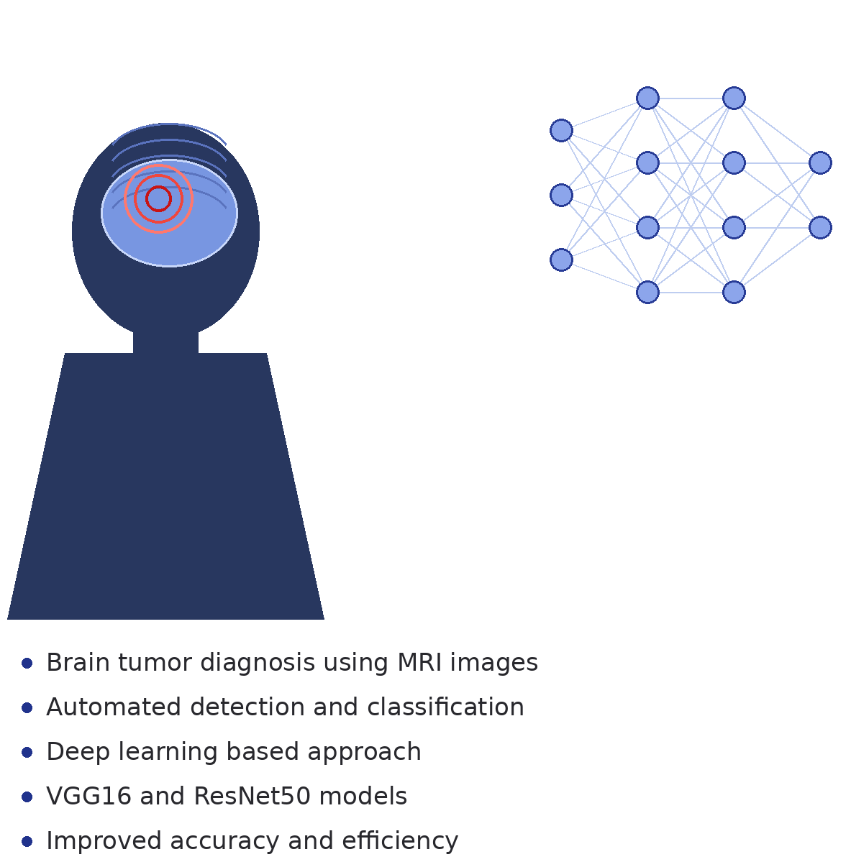
Abstract
Brain tumour diagnosis from MRI images
Manual analysis time-consuming
Deep learning-based automated detection
MRI image preprocessing
Tumor detection and segmentation
VGG16 and ResNet50 feature extraction
Brain tumor classification
Improved diagnostic accuracy

Slide 3
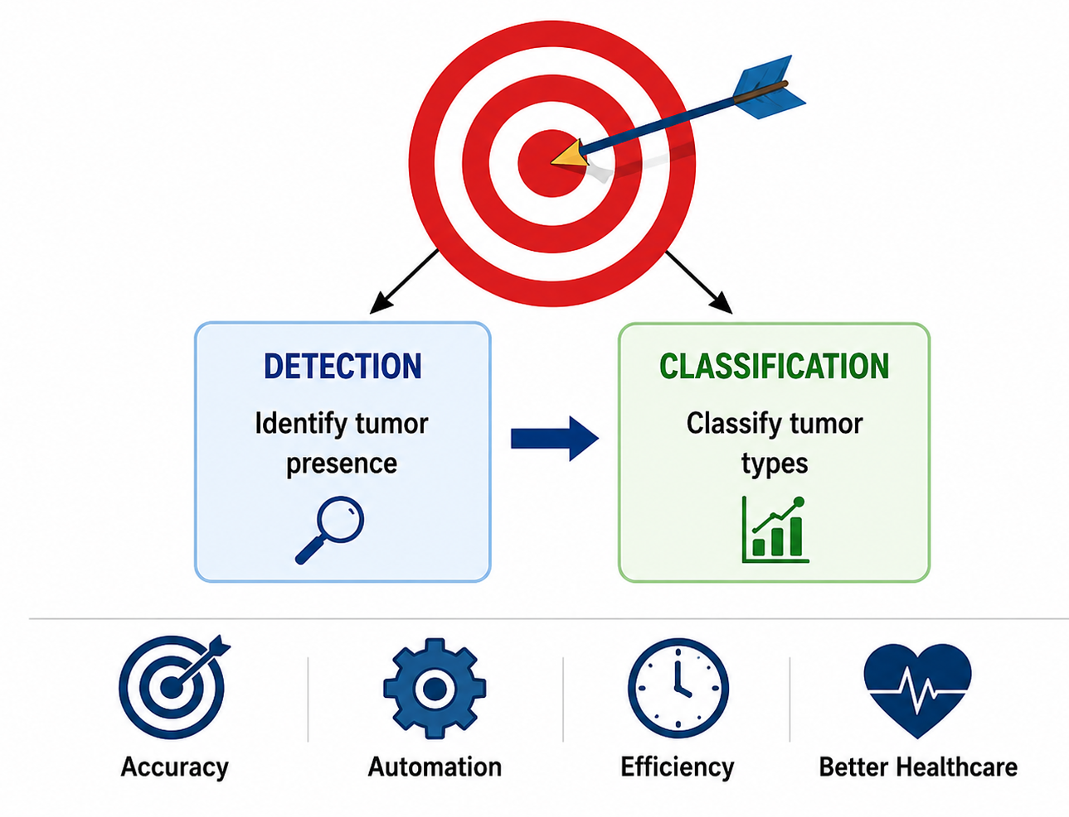
Aim & Objectives
Aim
Automatic brain tumor detection
Accurate tumor classification
Deep learning-based diagnosis
Reduced diagnostic time
Objectives
MRI image preprocessing
Tumor region detection
Feature extraction using VGG16
Feature extraction using ResNet50
Tumor classification
Performance evaluation

Slide 4
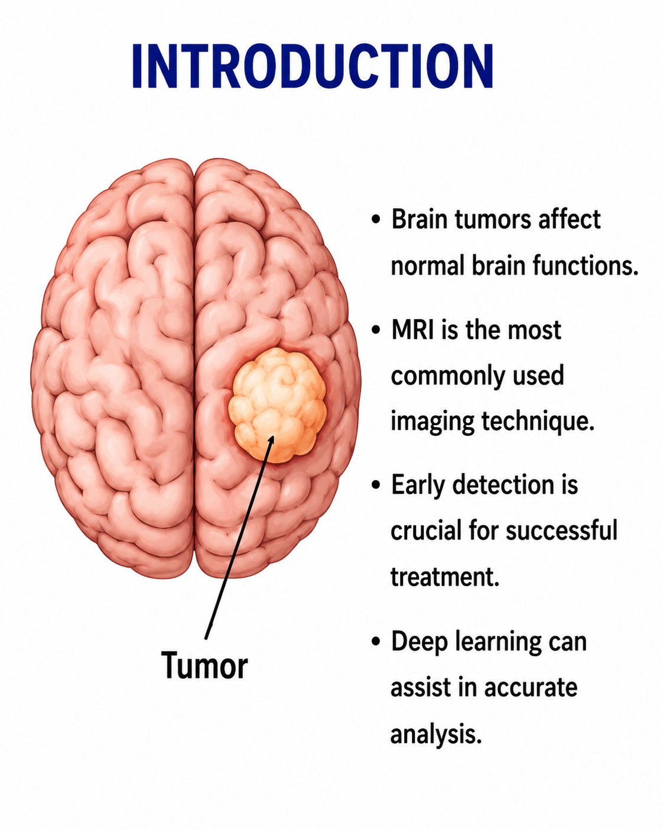
Introduction
Brain tumours affect neurological functions
MRI widely used for diagnosis
Manual diagnosis prone to errors
Deep learning improves accuracy
Automated healthcare support system

Slide 5
S.No | Year of Publication | Author | Title of the Journal / Book | Methodology Used | Algorithm Used | Key Findings
1 | 2021 | S. Deepak & P.M. Ameer | Brain Tumour Classification Using Deep CNN | MRI Image Analysis | CNN | Achieved high accuracy in brain tumor classification
2 | 2022 | A. Kumar et al. | Automated Brain Tumour Detection Using Deep Learning | Image Preprocessing & Classification | VGG16 | Improved feature extraction and detection performance
3 | 2022 | M. Sharma et al. | MRI-Based Brain Tumour Detection Using Transfer Learning | Transfer Learning | ResNet50 | Reduced training time with better classification accuracy
4 | 2023 | R. Gupta et al. | Deep Learning Approaches for Brain Tumour Analysis | Feature Extraction & Classification | CNN + ResNet50 | Enhanced tumor identification from MRI images
5 | 2024 | P. Singh et al. | Automated Brain Tumor Detection and Classification | MRI Segmentation & Classification | VGG16 + ResNet50 | Achieved robust multi-class tumor classification

Slide 6
Problem Statement
Brain tumours pose serious health risks and require early diagnosis.
Manual MRI image analysis is time-consuming and dependent on radiologists' expertise.
Traditional methods may produce inconsistent and less accurate results.
Large volumes of MRI scans make manual examination difficult.
An automated deep learning system is needed for accurate tumour detection and classification.

Slide 7
Existing System
Manual inspection of MRI scans by medical experts.
Conventional image processing and machine learning techniques.
Requires significant human intervention.
Lower accuracy for complex tumour patterns.
Longer diagnosis and treatment planning time.

Slide 8
Proposed System
Automated MRI image analysis using deep learning.
Image preprocessing and tumour region detection.
Feature extraction using VGG16 and ResNet50.
Classification of tumour types (Glioma, Meningioma, Pituitary, No Tumour).
Faster, more accurate, and reliable diagnosis support system.

Slide 9
Proposed Methodology and Algorithm
Algorithms Used
VGG16
Pre-trained CNN model
16-layer deep architecture
Feature extraction from MRI images
Transfer learning technique
High classification accuracy
ResNet50
50-layer deep neural network
Residual (skip) connections
Prevents vanishing gradients
Extracts complex features
Improves classification performance
MRI Brain Image Dataset Collection
Image Preprocessing (Resize, Normalize, Noise Removal)
Tumour Detection and Segmentation
Feature Extraction using VGG16 and ResNet50
Brain Tumour Classification and Performance Evaluation

Slide 10
Design & Module Planning
Module 1: MRI Image Acquisition
MRI Dataset Collection
Data Labelling
Dataset Organization
Train/Test Split
Data Validation
Module 2: Image Preprocessing
Image Resizing
Noise Removal
Normalization
Contrast Enhancement
Image Augmentation

Slide 11
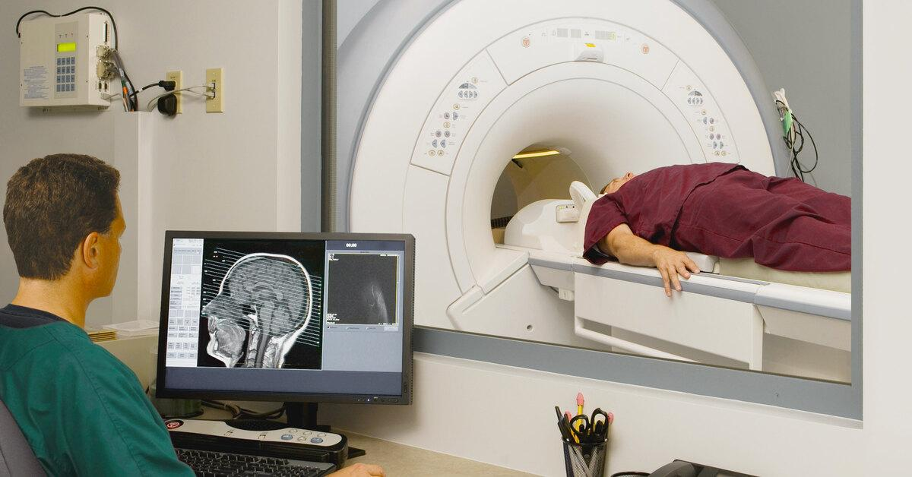
Module 1: MRI Image Acquisition
Objective
To collect, organize, and prepare MRI brain images for tumour detection and classification.
Key Activities
Collect MRI brain image dataset
Label tumour categories accurately
Organize images into folders
Split data into training and testing sets
Validate dataset quality and consistency
Input
MRI Brain Images
Output
Prepared and labelled MRI dataset

Slide 12
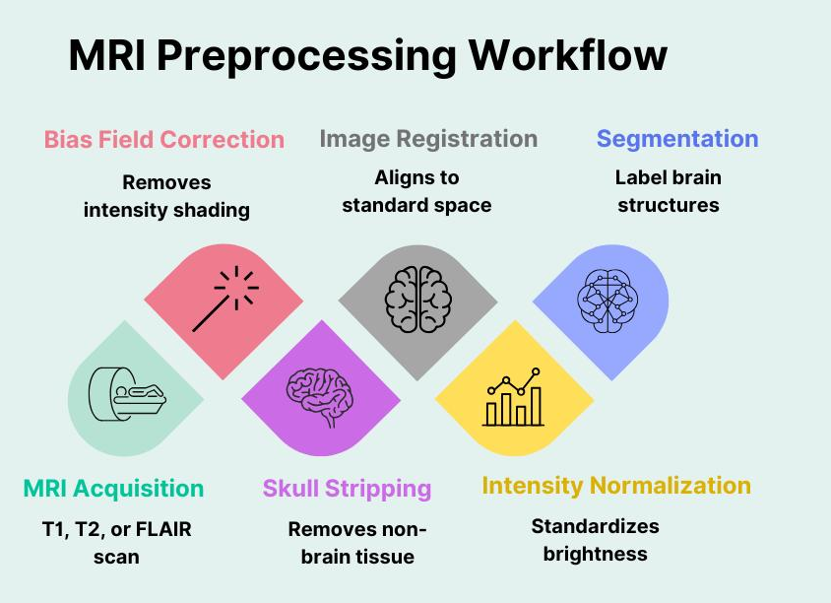
Module 2: Image Preprocessing
Objective
To enhance MRI images and prepare them for accurate tumour detection and classification.
Key Activities
Resize MRI images to a standard size
Remove noise and unwanted artifacts
Normalize image pixel values
Enhance image contrast and clarity
Apply data augmentation techniques
Input
Raw MRI Brain Images
Output
Pre-processed MRI Images

Slide 13
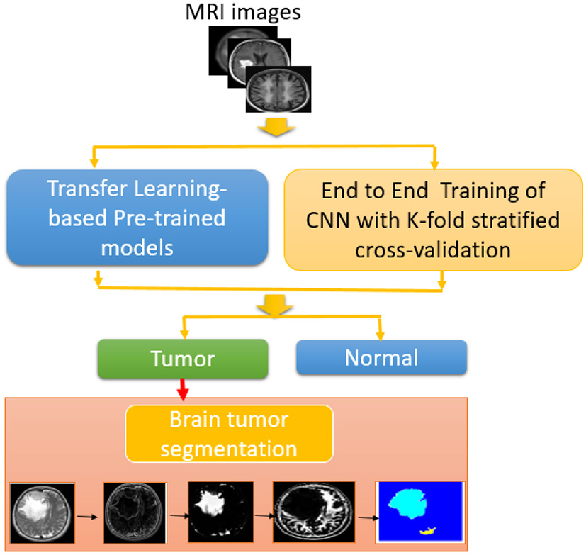
Module 3: Tumour Detection & Segmentation
Objective
To identify the tumour region in MRI images and accurately separate it from healthy brain tissues.
Key Activities
Detect tumour regions in MRI images
Extract Region of Interest (ROI)
Segment tumour boundaries
Localize tumour position
Generate segmented tumour output
Input
Pre-processed MRI Images
Output
Detected and Segmented Tumour Region

Slide 14
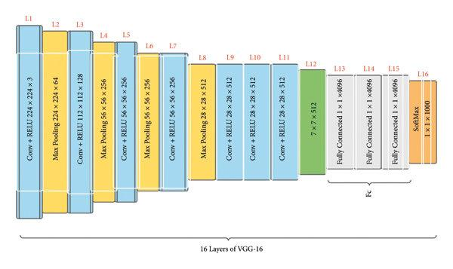
Module 4: Feature Extraction
Objective
To extract important tumour features from MRI images using deep learning models VGG16 and ResNet50.
Key Activities
Apply VGG16 model
Apply ResNet50 model
Extract deep image features
Learn tumour characteristics
Generate feature vectors
Input
Segmented Tumour Images
Output
Extracted Deep Features

Slide 15
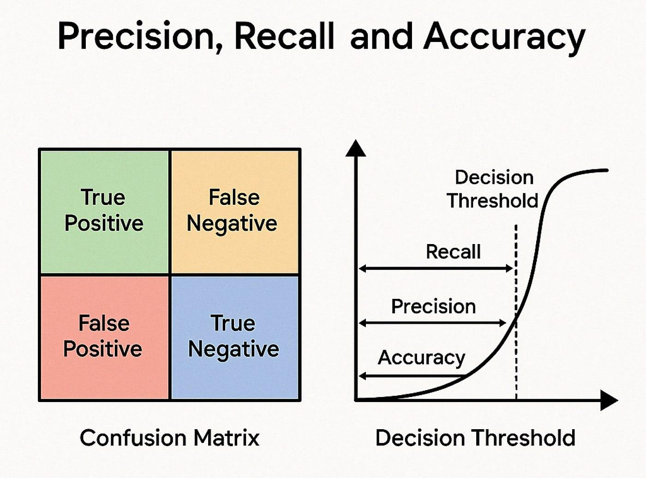
Module 5: Classification & Evaluation
Objective
To classify brain tumours and evaluate the performance of the deep learning models.
Key Activities
Classify tumour categories
Generate prediction results
Calculate performance metrics
Compare model performance
Visualize final results
Input
Extracted Deep Features
Output
Classified Tumour Type and Performance Metrics

